Slide 1
Book-it
Stephanie Chua for OCBC Cinemas

Slide 2
Book-it
BOOK-IT is a mobile app that enables consumers to book movie tickets on the go. It is designed exclusively for OCBC cinemas.

Slide 3
Customer journey before booking
User reviews: Limited compared to IMDb, exits to view IMDb
Collecting Real Tickets allow user to look back at the time spent with friends and mobile tickets are ugly, decides to book in person.
Finding out about movie
Through social media and word of mouth.
1
3
5
2
4
Theatre apps: Movie profile only has summary seen, no trailer; Switches to YouTube.
Shares YouTube video: Gets friends/ family to join them to watch the movie

Slide 4
Customer journey Booking process
Unclear :
Some seats are reserved for couples and not for single booking.
Frustration in figuring that out leads user to book on website instead when she reaches home
Unable to decide : Not sure what friends would like to eat on that day
FOMO: Flooded with deals on Google and social media
1
3
5
Back and forth between show timings/ venues as pricing is only shown upon selection of seat
2
4
6
Time-limit : Unable to go through snack promotions properly due to time limit after seat reservation
Troublesome : Typing in credit card numbers.

Slide 5
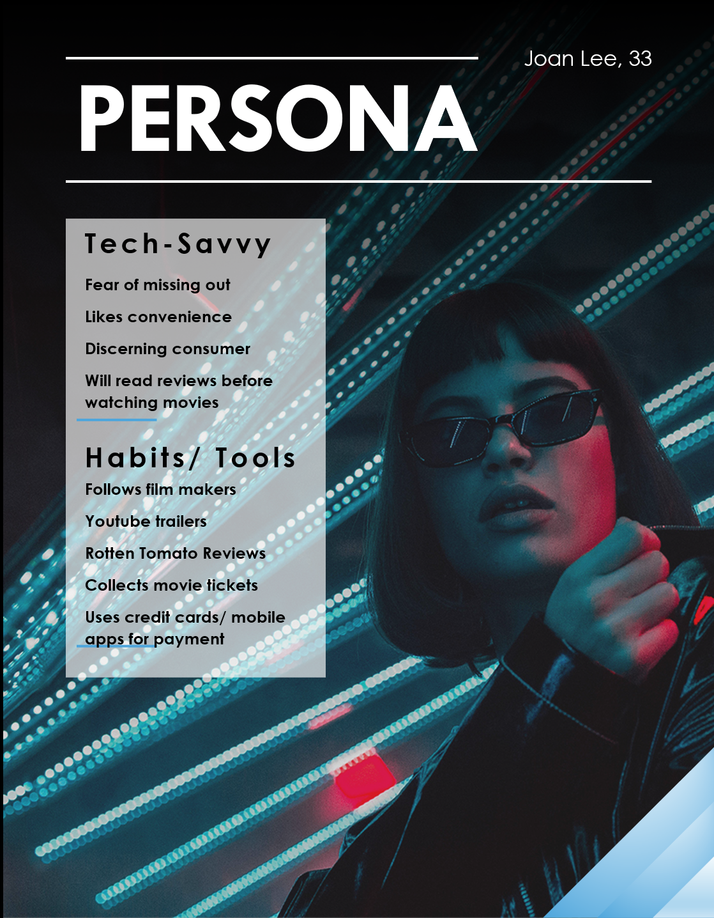
UNIQUE
Joan is outgoing and sociable and likes to be in the scene. She recently went to the Ice Cream Museum. She took many pictures with her friends and uploaded it to Instagram. She values Instagram as each post represents the most beautiful snapshot of a memory that she would remember for years to come.
Payments
Social Channels
Credit Cards
Apple Pay
Instagram
Facebook
Sources of Information
Social Media
Friends
YouTube
Rotten Tomatoes
IMDb
Google

Slide 6
MARKET OVERVIEW
19 million tickets
15.3%
64.73%
Sold per year before COVID.
This is a relatively small drop in ticket sales compared to Singapore’s historical high of 22 million in 2011.
New Entrants: Complement or Competition?
Current estimates by PwC put the compound annual growth rate of revenue from on-demand video here to be at 15.3 per cent between 2019 and 2024.
Of the gadgets in Singapore are mobile devices. Having a good app installed on user’s devices is important in ensuring availability of delivering ticket sales.

Slide 7
PROBLEM
There has been a relatively slight decrease in movie tickets sold over the decade. There is still great interest in the experience of going to a movie. Consumers comment that it takes months to a year before it is available on demand.
Continued strength
Weakness: app design and user engagement
Interviews have revealed that mobile apps in Singapore for this market are difficult to use, usually unattractive, and do not have the content that users want. They end up turning to YouTube, IMDB, or on the web booking.
Threat: on demand streaming
On demand streaming market has been bolstered and in fact, expedited by the COVID situation. That is seen in forecast numbers and in our interviews.
Opportunity
How do we boost the appeal of a movie theatre experience while potentially capitalizing on the advent of on-demand streaming?

Slide 8
demo

Slide 9
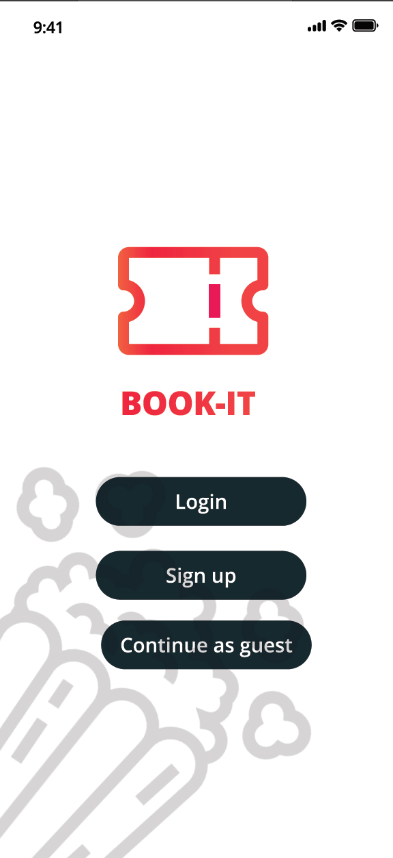
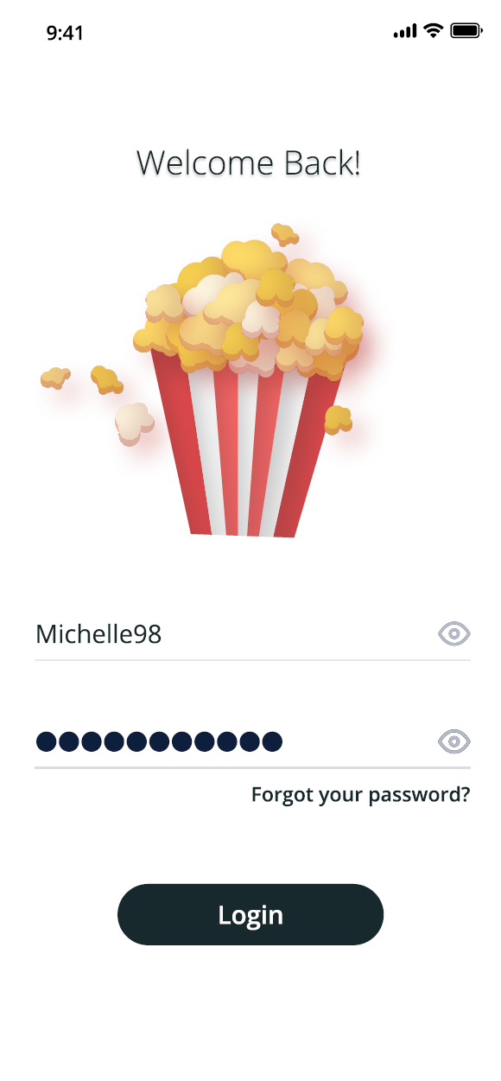
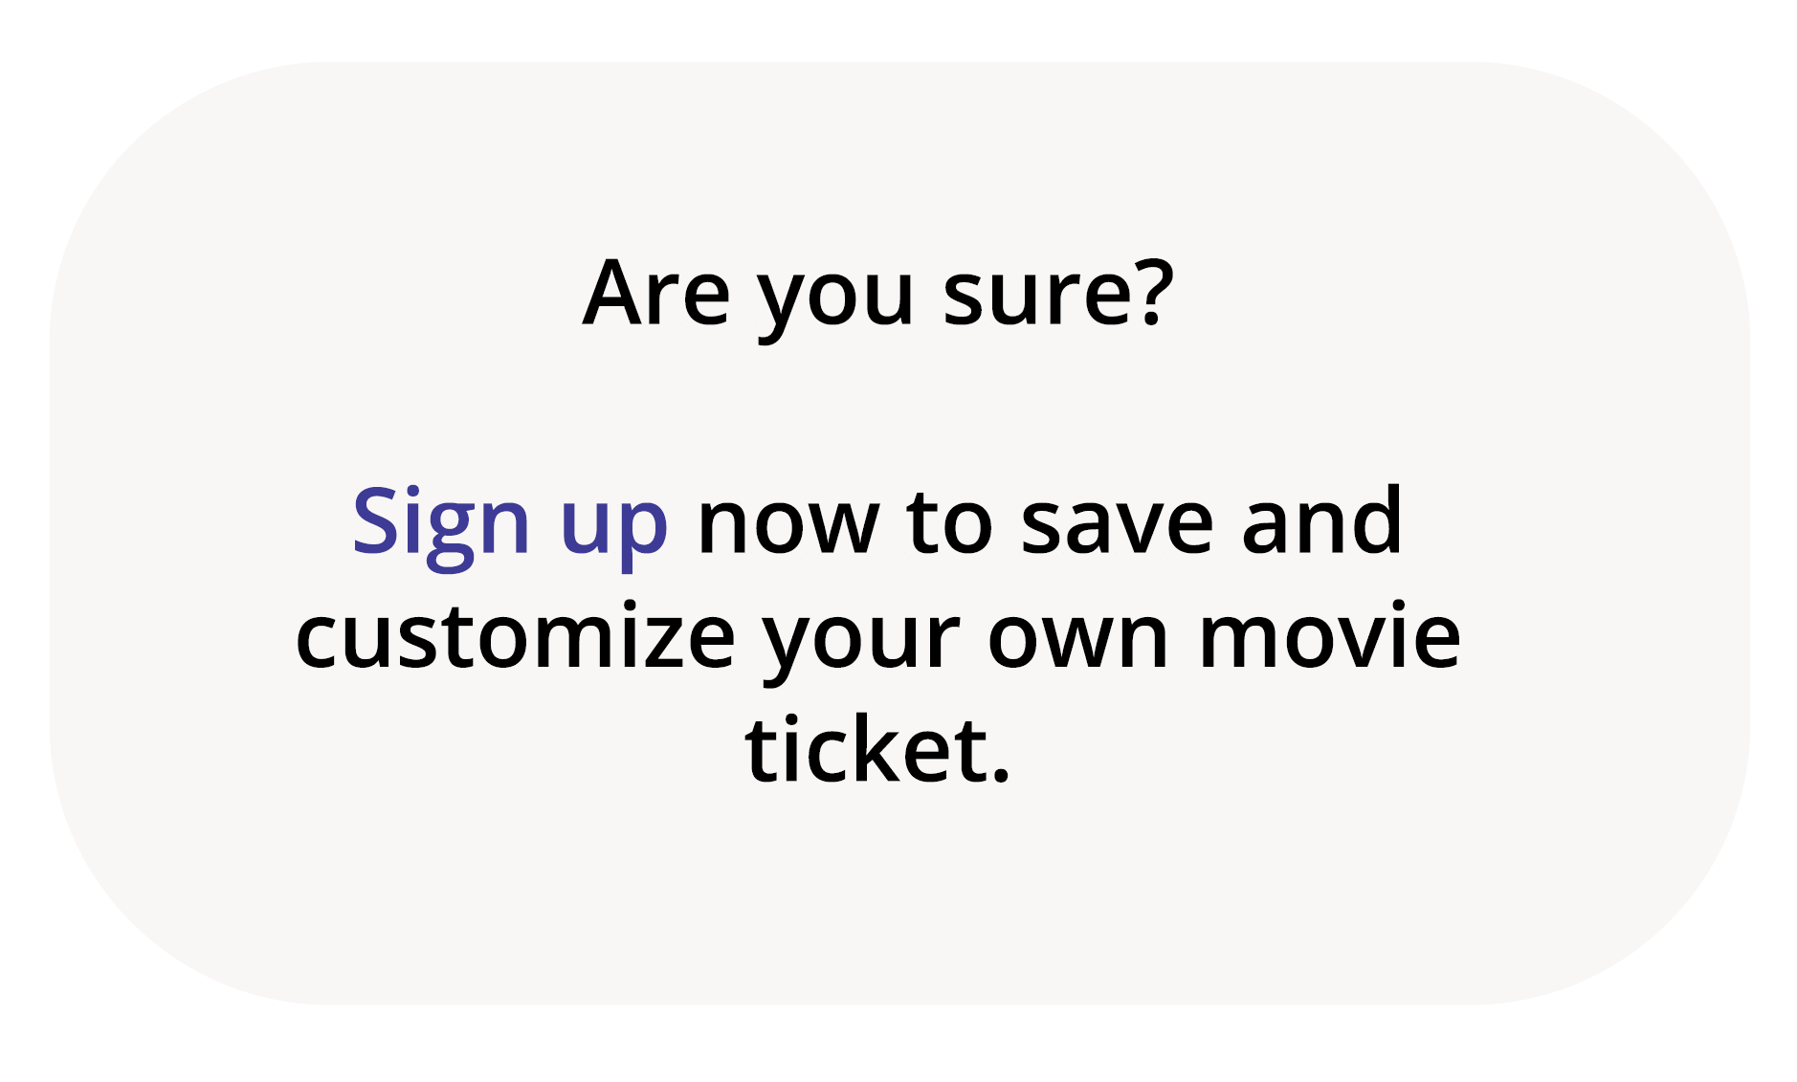
Welcome page
Give users a choice to book ticket or simply look around without the need to go through sign up process

Slide 10
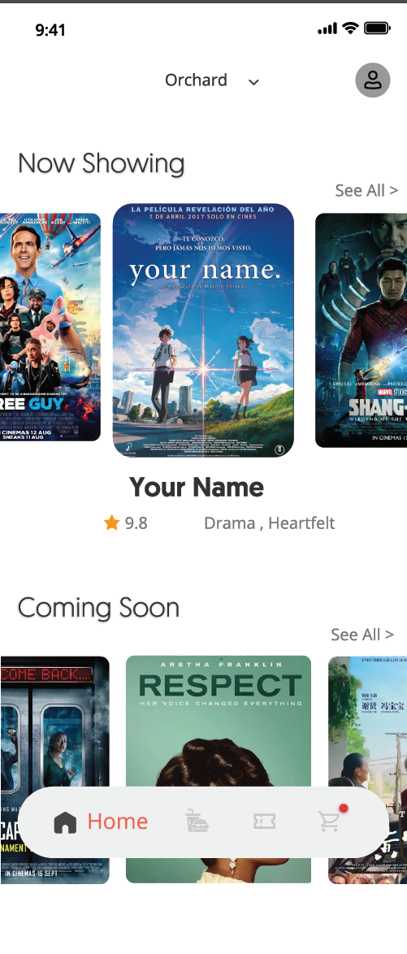
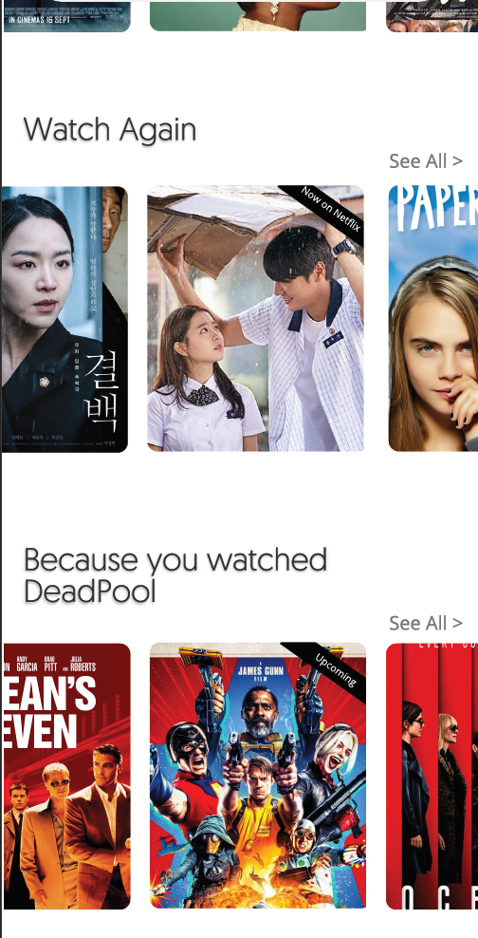
Home Page
Overflow
Allow users to view available movies by preferred location
Capitalize on Data: Push users to new content based on preferences
User may view and add food menu options to their cart before booking tickets, so that they do not have to select between food options and promotions with a time limit
Tip! In post-production interviews, users commented that this felt too much like Netflix, hence “Now Showing” and “Coming Soon” was placed on top to give a visual cue of the purpose of the app

Slide 11
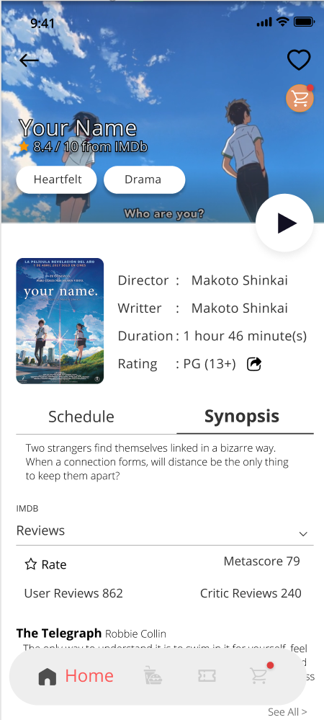
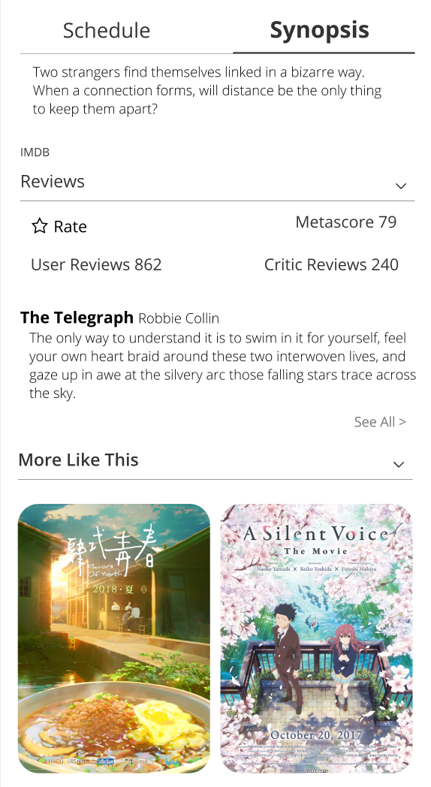
Movie Profile page
Overflow
Trailer: So that users don’t have to exit the app to YouTube when deciding on a movie to watch
Book Tickets:
Allow users to select timings from same page
Share: Users may invite their friends to catch this movie with them
Capitalize on Data: Push users to similar content
Movie Information:
Fetch information like reviews and names of cast members from IMDb

Slide 12
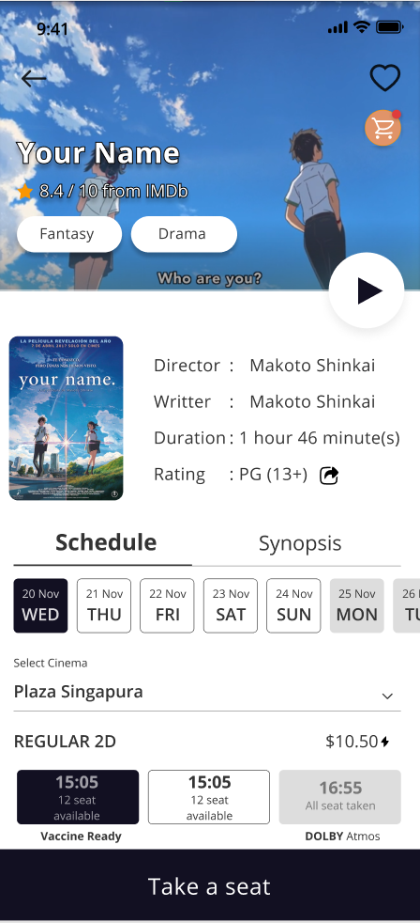
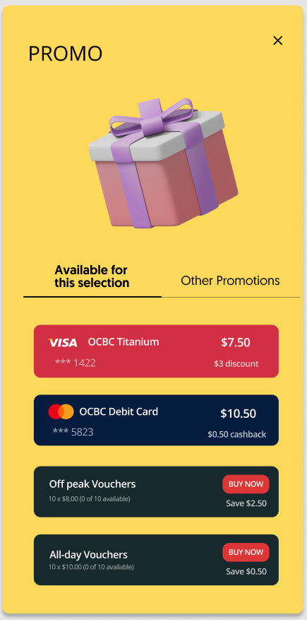
Select screening times
Pop-up
Information at a Glance
Date, Day and Time of screening, Location, Price, Type of theatre, Seats available
Lightning bolt
Indicates intelligent suggestions on promotions available, so that users do not have to search the web
Easy to read
Day and Time of screening is in large font so that users instinctively know whether they are available to watch the movie, rather than having to translate dates to days of the week.
Price is made available so that price sensitive users can quickly flip through the options to aid decision making.

Slide 13
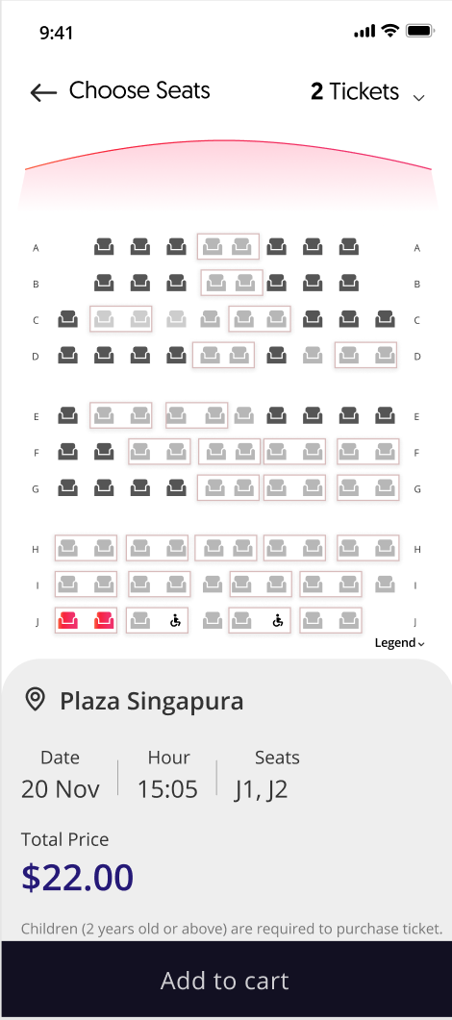
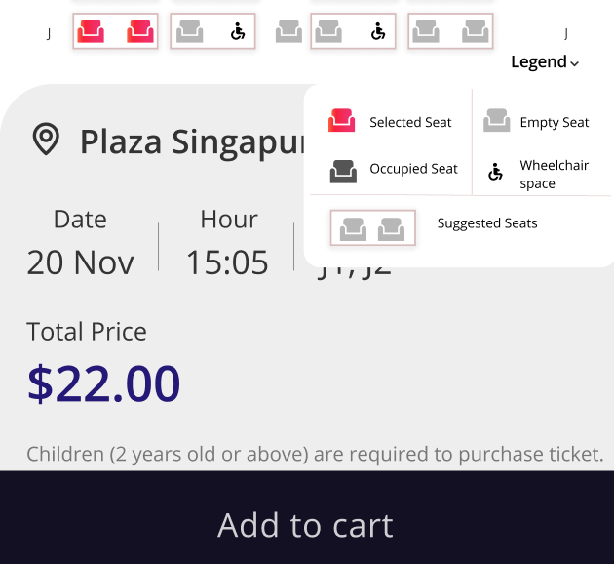
Select seats
Seat Selection Suggestions:
In order to maximize occupancy, theatres want to minimize spaces between groups of people. However, users are frustrated when they try to select a seat and are met with an error message. Smart suggestions can aim to minimize this issue while actively helping users select a seat.
Legend Pop-up

Slide 14
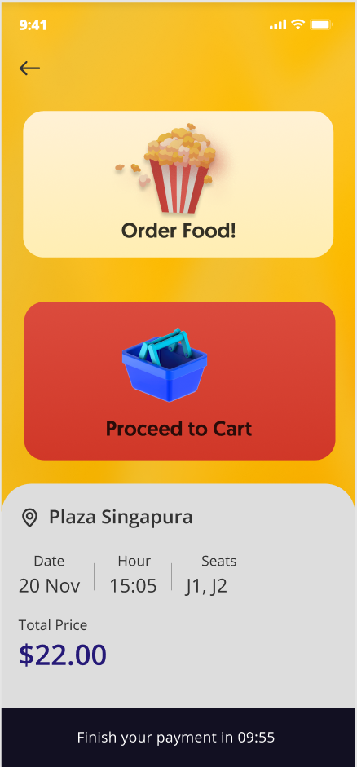

Transition page
Simplify Selection:
Instead of bombarding users with food options, we simplify the decision process by asking whether they’d like to order food now or at the theatre.
Users may also select food options in the dedicated menu tab.
This means that there are items in cart are waiting to be checked out.
Seats are reserved for 10 minutes to prevent double booking during payment

Slide 15
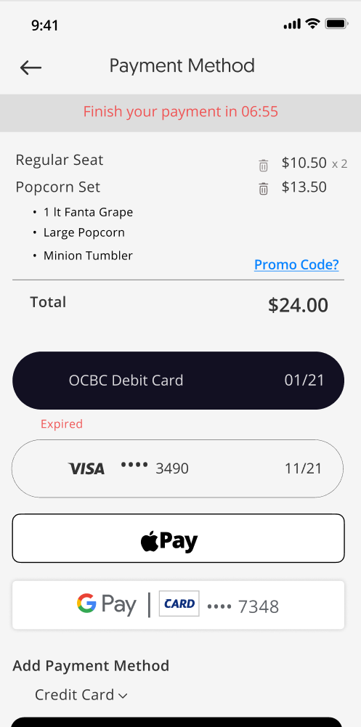
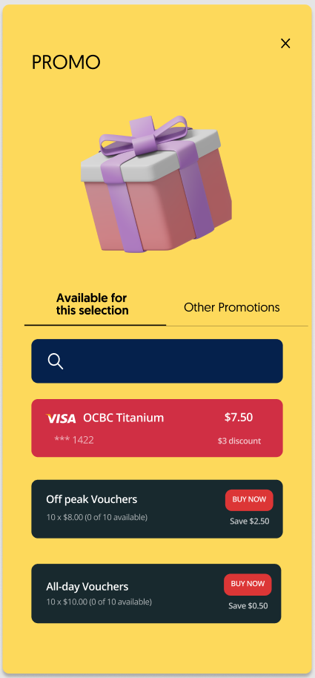
cart
PROMO Pop-up
Promo code
Allow users to select promotions if they have not selected yet, or to enter PROMO CODE given for B2B collaborations, employee benefits, corporate gifts and other vouchers
Apple pay
Allow unregistered users to make payment easily without having to enter credit card details.

Slide 16
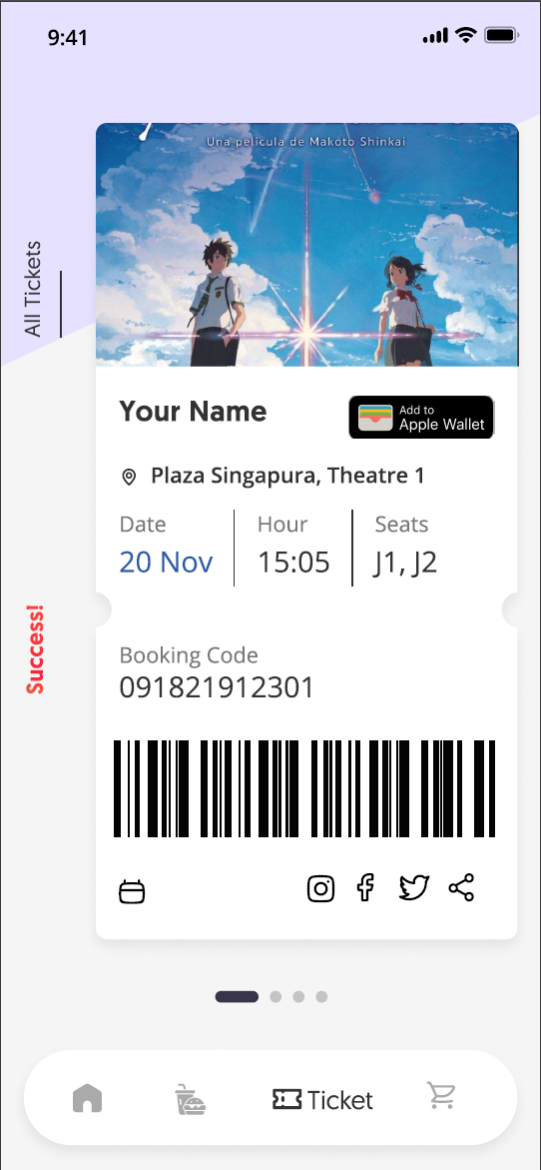
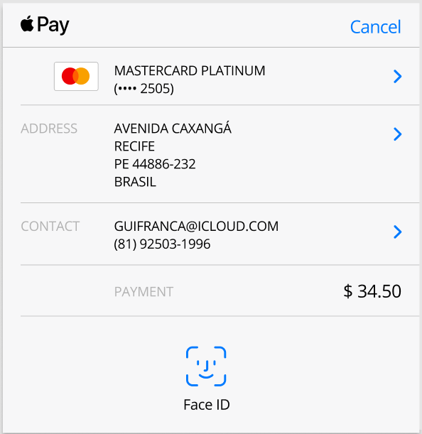
Authentication transition

Slide 17
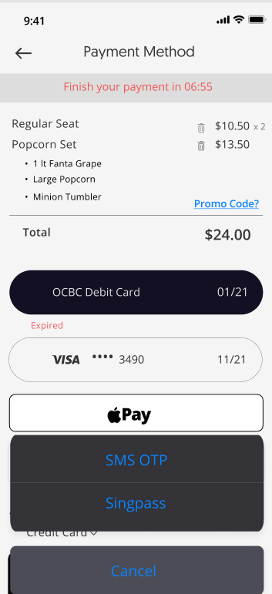
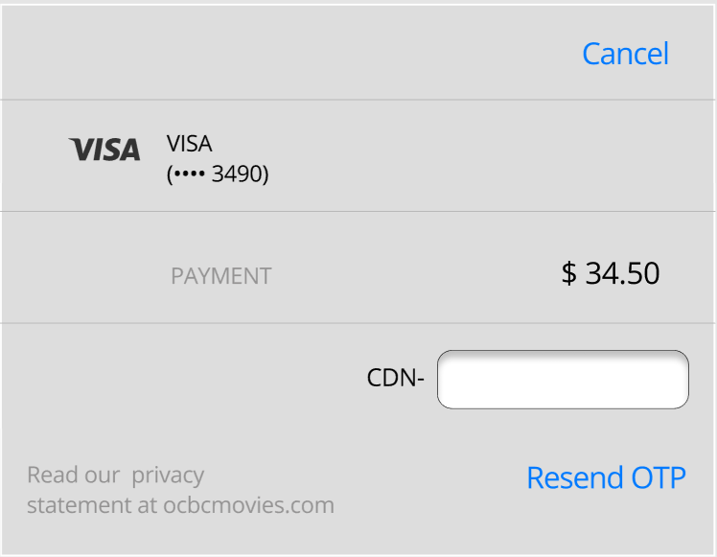
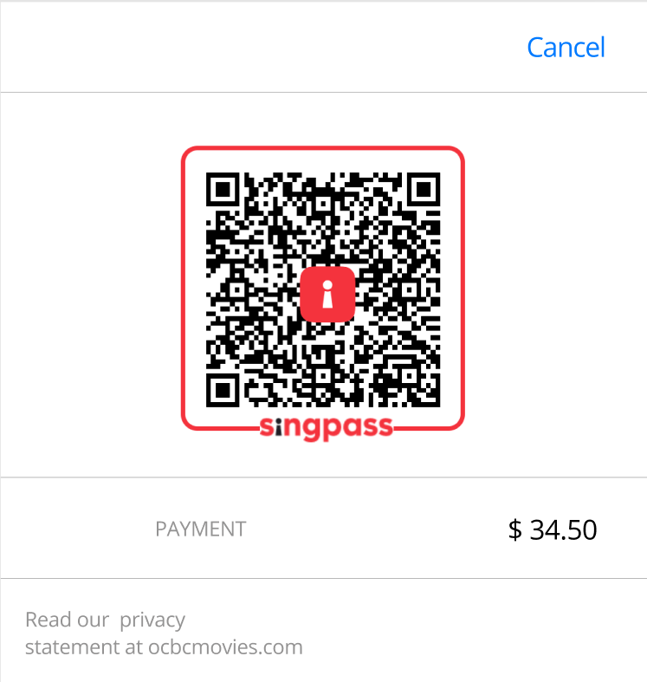
Credit Card Authentication transition

Slide 18
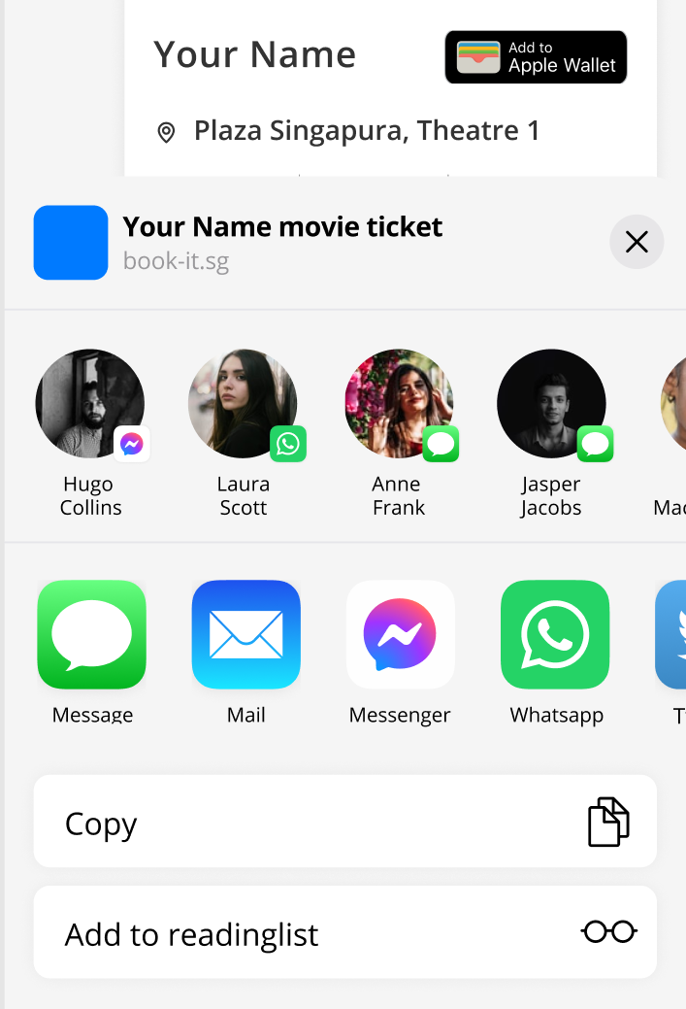
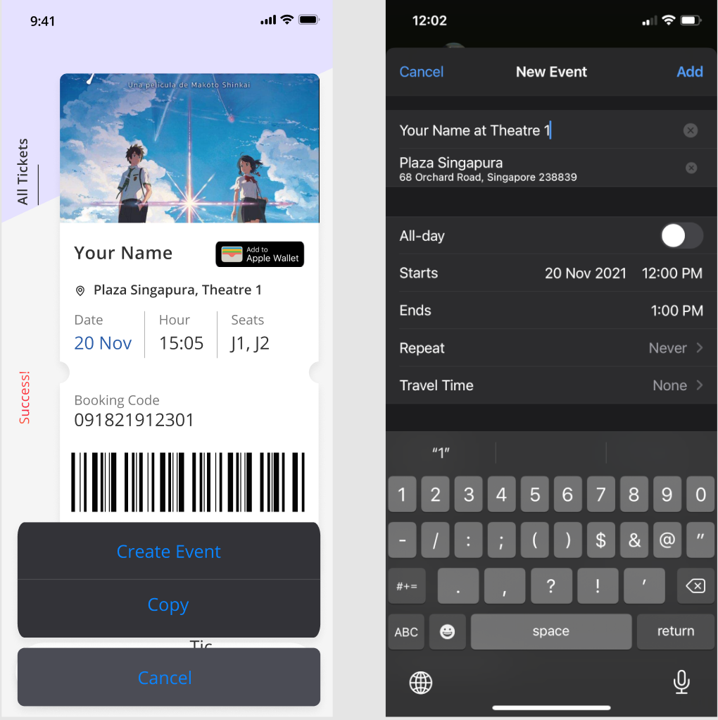
Success page
4
6
Save ticket
1
In Apple Wallet or Google Pay to enable easy access to tickets while entering theatre.
2. Share to friends /email
Calendar
Share ticket with friends who bought the ticket with you or email yourself a copy of the ticket.
3. Save to calendar
3
2
Allow users who don’t have Apple Wallet or Google Pay to save a reminder easily.
5
4. Customizable feature
Allow users to change the default movie picture.

Slide 19
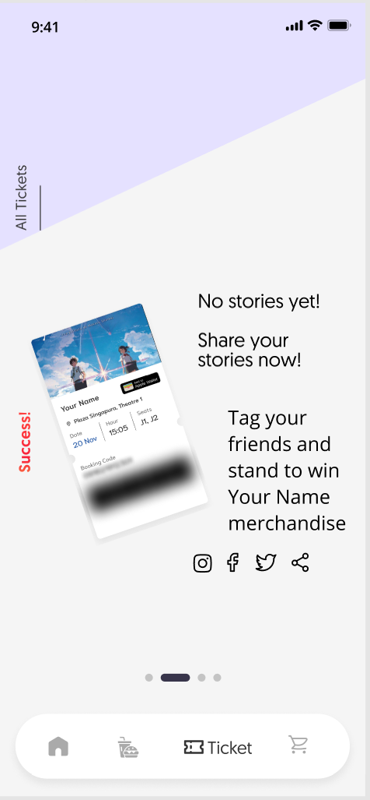
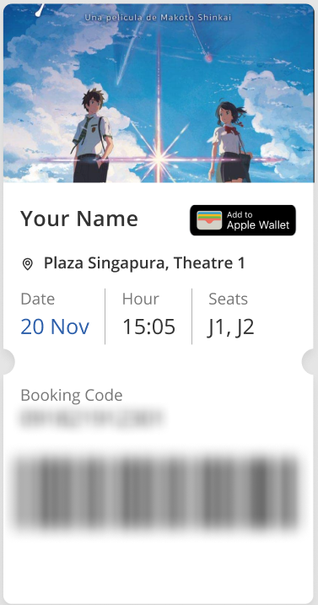
Memories
5. Drive user engagement
Mask booking information automatically to allow users to share ticket as stickers on their stories in the various social media platforms.
Give movie franchises an avenue for social media campaigns.
Users will be able to look back at the memories made at the movies. Increasing the retention rate of the app.

Slide 20
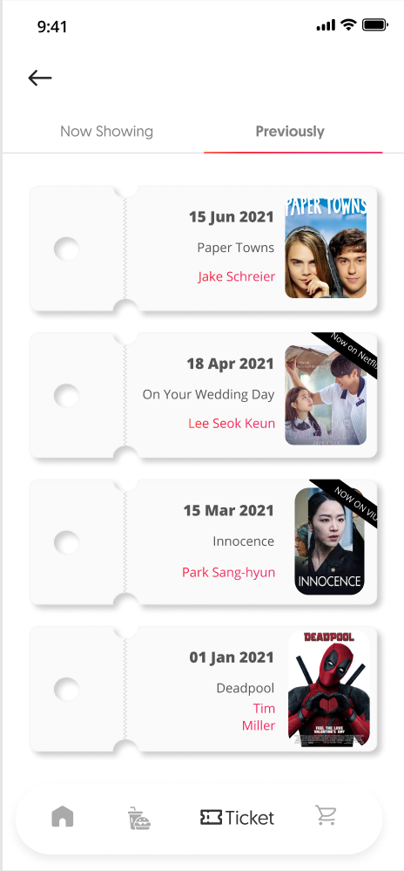
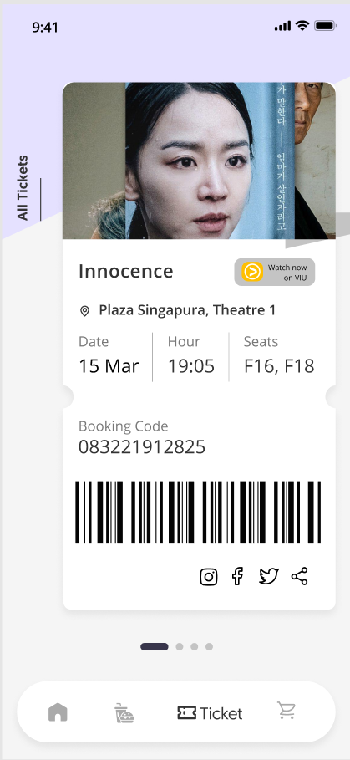

Memories
6. Past tickets
Users will be able to look back at movies they have seen before.
We will be able to collaborate with on-demand options to earn referral fees or have B2B collaborations where we host screenings of Netflix/VIU audience favorites.
Memories of previous user generated stories will be kept here.
Additional pages of similar movie suggestions may be added as well.

Slide 21

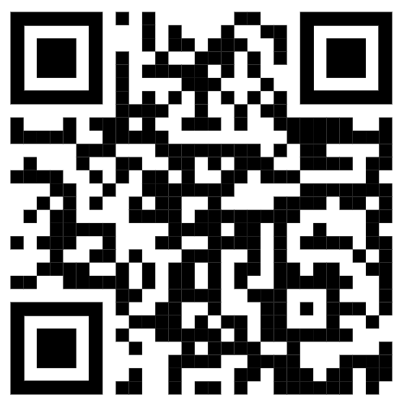
Add a QR code to movie posters
On their way out of the theatre, users can scan the QR code and be directed to the movie’s profile page to either book or save the date!

Slide 22
Creating a symbiotic relationship
We let users know that their favorite movie is now available on-demand.
OCBC Cinemas
On-Demand Streaming
Receive opportunities for screenings we may not have had without the data-driven wisdom of what is popular among past movies.

Slide 23
Value proposition
CLOSE THE GAP
TARGET AUDIENCE
Our product makes consumer lives easier, by consolidating the movie ticket booking journey into one app and providing digital tickets that can be kept and shared for memories.
Our target audience are the Digital Natives and Residents who thrive on social media and appreciate experiences that can be recorded on their digital footprint.
CAPITALISE ON
INCOMING THREATS
EASY TO USE
Hyper-personalization allows us to take a cut when we refer consumers to on-demand streaming services and collaborate with these services to bring back screenings of popular movies based on their user pool and user data.
Simple design that gives customers the targeted information they need.

Slide 24

THANK YOU
Stephanie Chua
+65 9741 7109
csq.stephanie@gmail.com
Github: @cotldus
LinkedIn: in/chuastephanie

